Slide 1
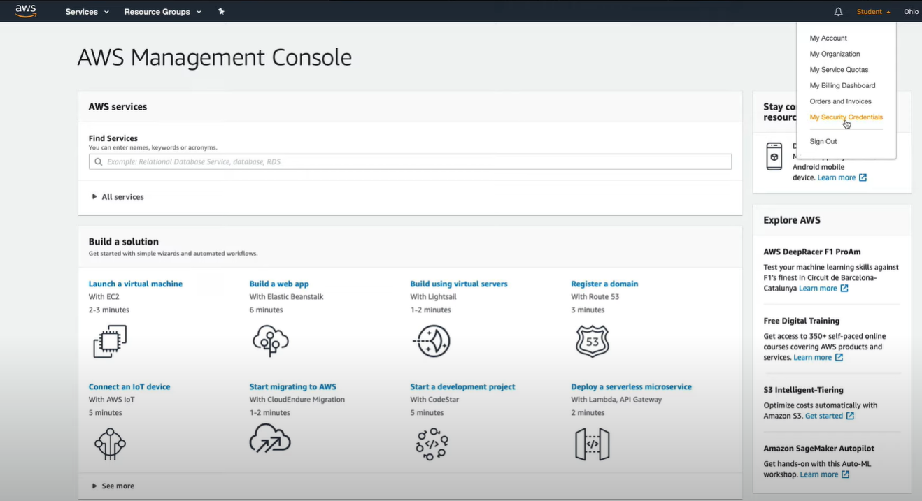
Securing Root User With MFA
Intro to Cloud Computing https://www.udacity.com/course/intro-to-cloud-computing--ud080

Slide 2
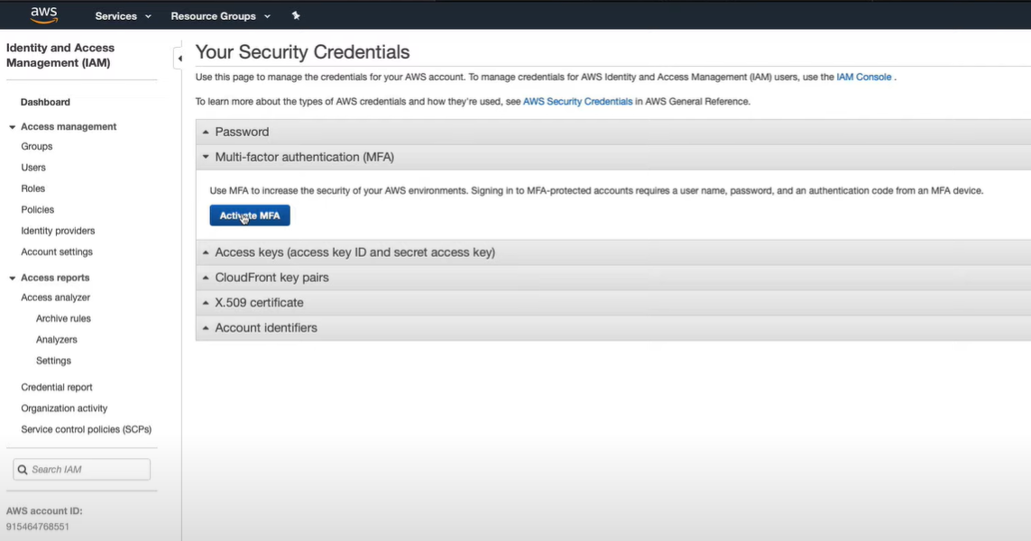
Securing Root User With MFA
Intro to Cloud Computing https://www.udacity.com/course/intro-to-cloud-computing--ud080

Slide 3
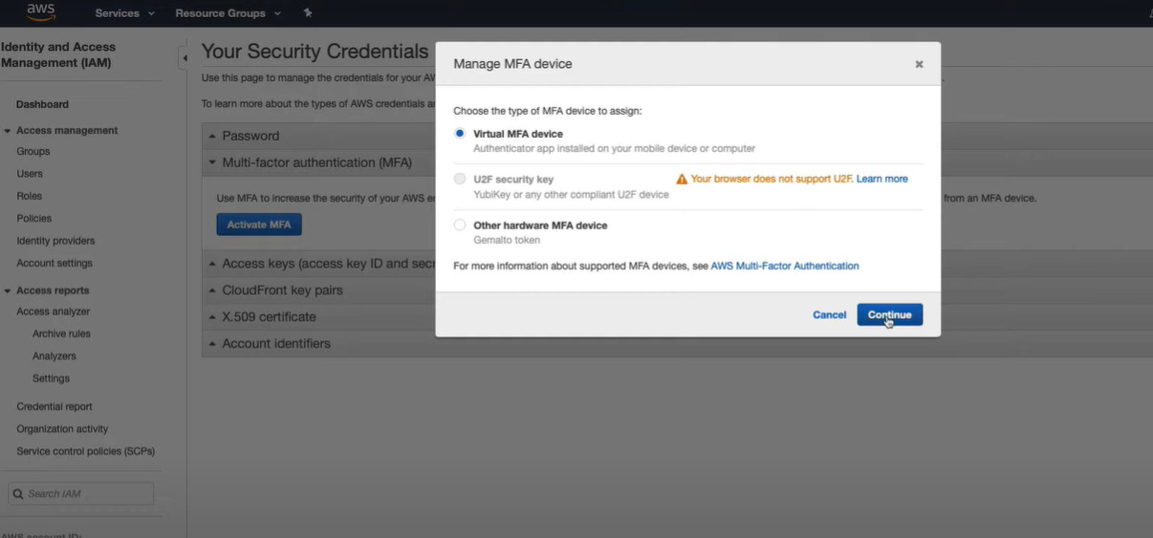
Securing Root User With MFA
Intro to Cloud Computing https://www.udacity.com/course/intro-to-cloud-computing--ud080

Slide 4
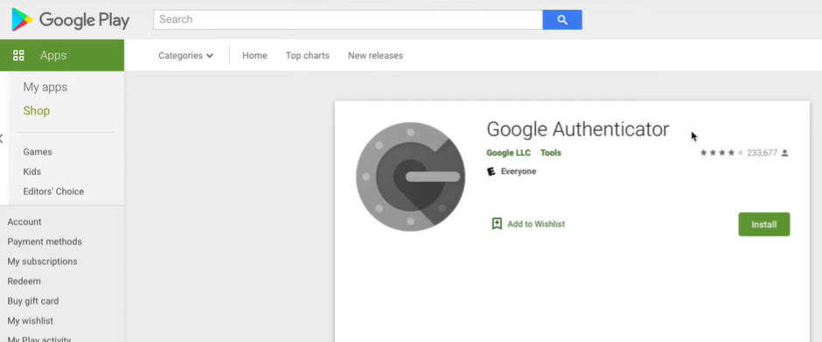
Securing Root User With MFA
Install Google Authenticator app.
Intro to Cloud Computing https://www.udacity.com/course/intro-to-cloud-computing--ud080

Slide 5
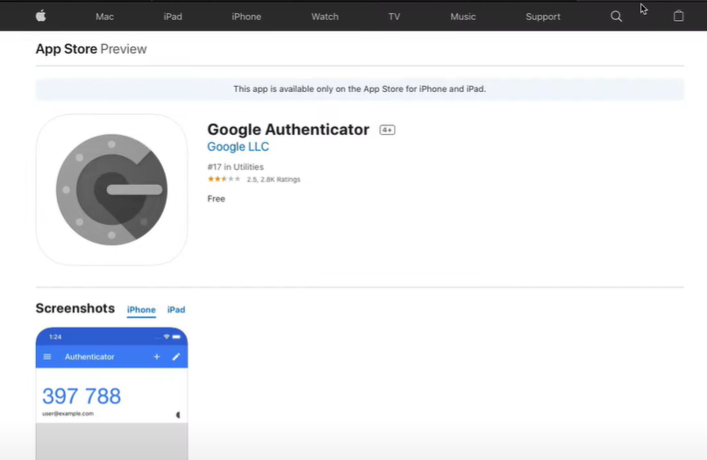
Securing Root User With MFA
Intro to Cloud Computing https://www.udacity.com/course/intro-to-cloud-computing--ud080

Slide 6
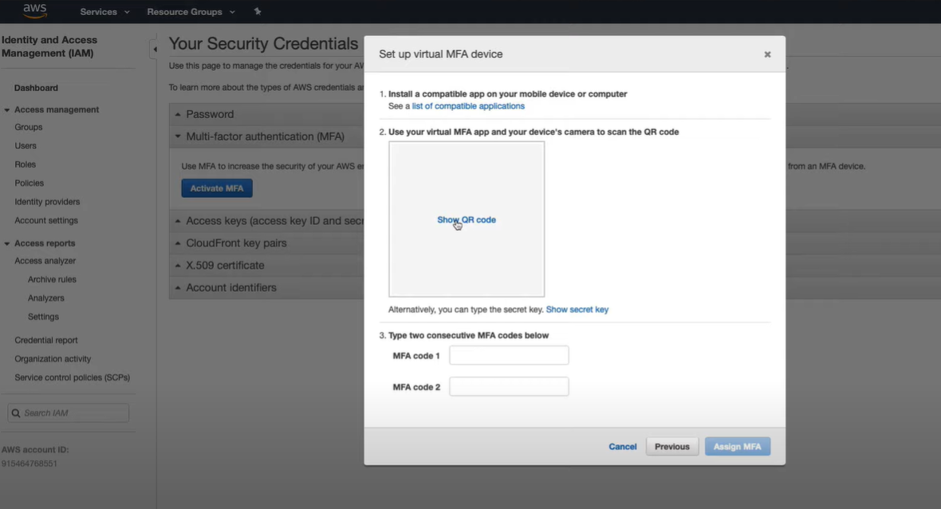
Securing Root User With MFA
Intro to Cloud Computing https://www.udacity.com/course/intro-to-cloud-computing--ud080

Slide 7
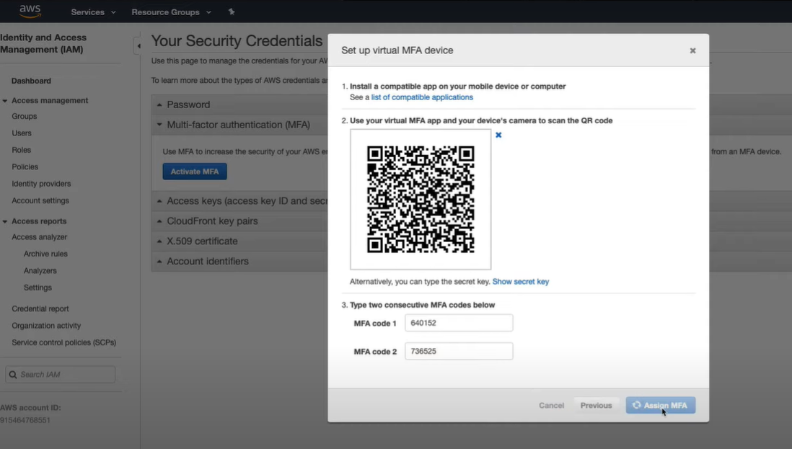
Securing Root User With MFA
Intro to Cloud Computing https://www.udacity.com/course/intro-to-cloud-computing--ud080

Slide 8
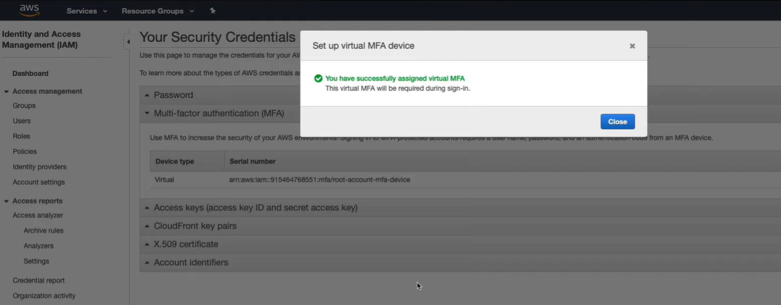
Securing Root User With MFA
Intro to Cloud Computing https://www.udacity.com/course/intro-to-cloud-computing--ud080

Slide 9
Exercise: Creating A Manager IAM User With Built-in Policies
In this exercise, you will create an IAM user for a manager, and apply built-in IAM policies.
Instructions
Create an IAM user
Name the user "manager"
Provide this user with:
  IAM Full Access permissions
  S3 Full Access permissions
  EC2 Full Access permissions
Intro to Cloud Computing https://www.udacity.com/course/intro-to-cloud-computing--ud080

Slide 10
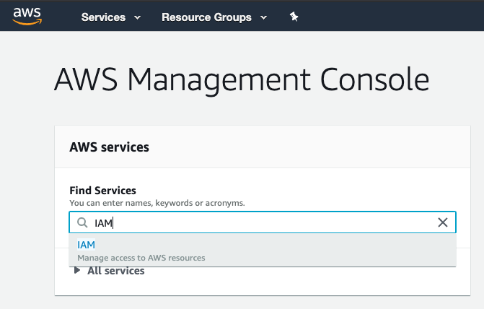
Exercise: Creating A Manager IAM User With Built-in Policies
Creating An IAM User
While logged in as the root account user, navigate to the IAM console.
Intro to Cloud Computing https://www.udacity.com/course/intro-to-cloud-computing--ud080

Slide 11
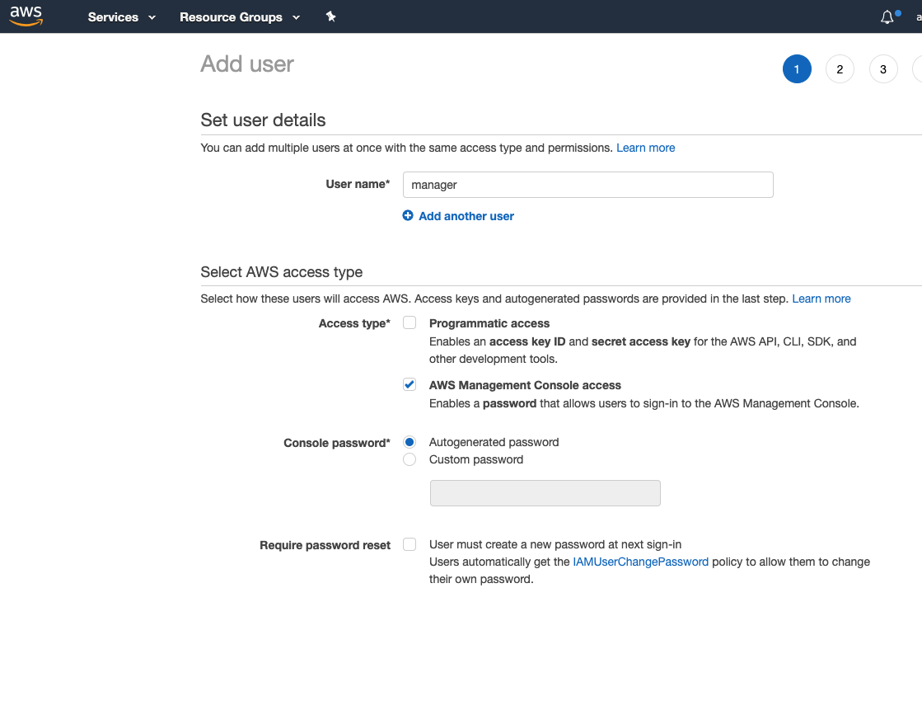
From the left sidebar click on Users to get into the Users page
Click the Add User button and set the User name to manager
Select the AWS Management Console Access access type
Leave the Autogenerated password on
Uncheck the option for Require password reset
Click on the Next: Permissions button

Slide 12
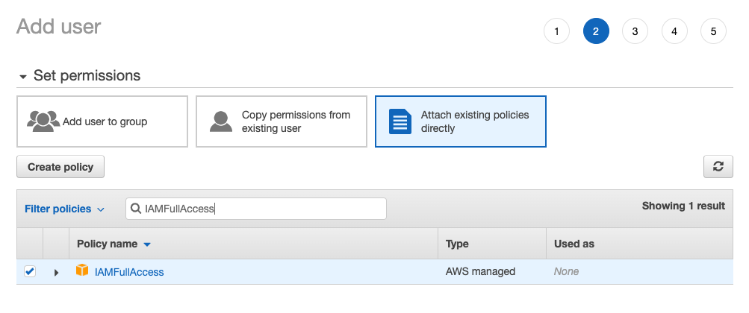
7. Click on the Attach existing policies directly button
8. Search for IAMFullAccess and select it

Slide 13
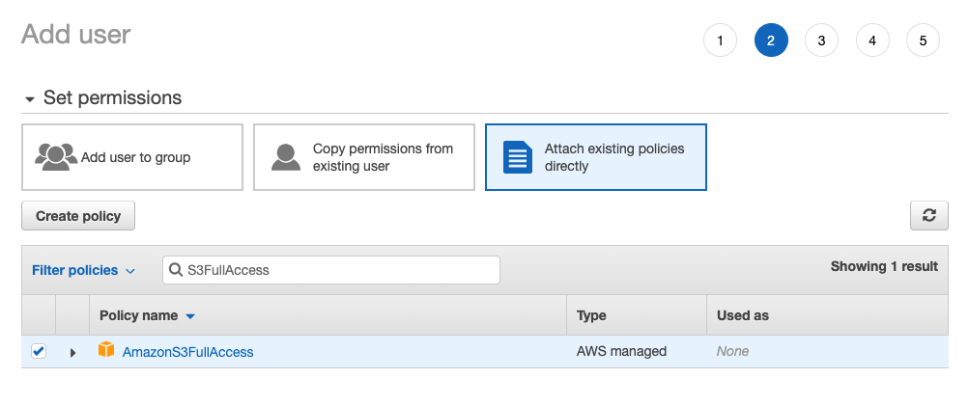
9. Search for S3FullAccess and select it

Slide 14
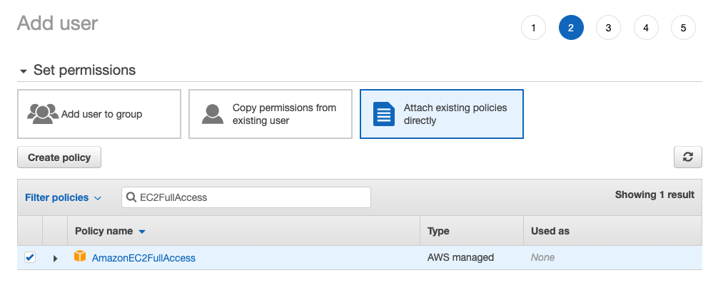
10. Search for EC2FullAccess and select it

Slide 15
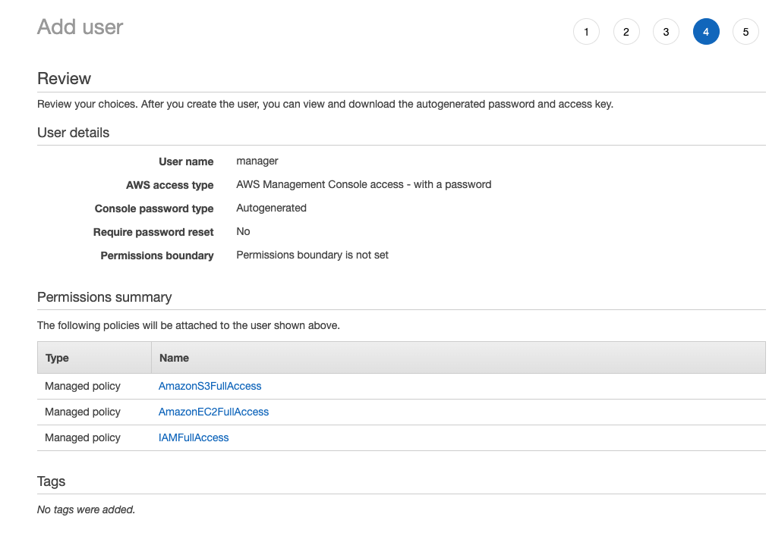
11. Click on the Next: Tags button. We don't need to add any tags at the moment, so skip the tags by clicking on the Next: Review button

Slide 16
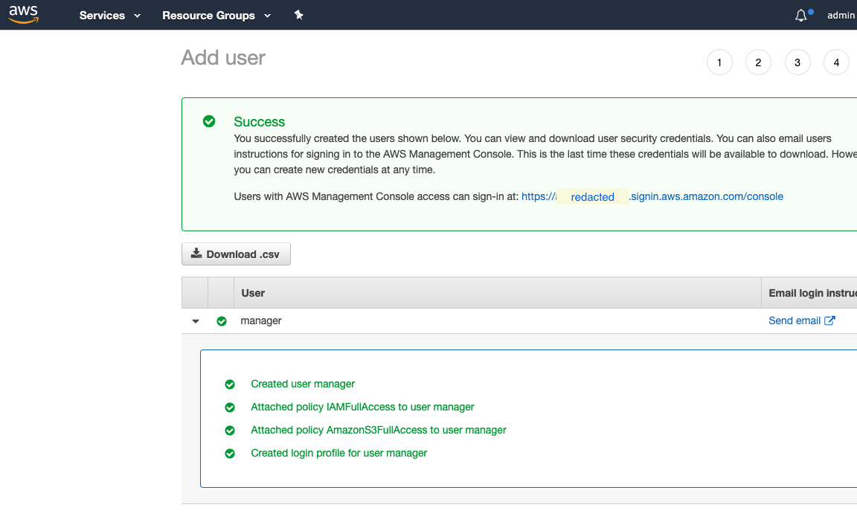
12. Click on the Create user button to create the user
Copy and save both the password (show password) and the login URL somewhere you will be able to access it later

Slide 17
Exercise: Securing IAM User With MFA
Instructions
If you have not yet done so, you must first create a manager AWS account
Install an MFA app on your phone - the Google Authenticator app (Android, iOS) is a good choice
Secure the manager account with MFA
Log out and log back in to verify that MFA is enabled
Intro to Cloud Computing https://www.udacity.com/course/intro-to-cloud-computing--ud080

Slide 18
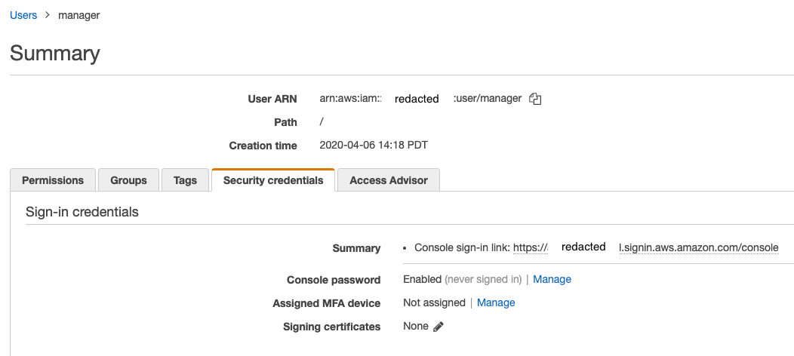
Navigate to the IAM console and select the user you want to secure with MFA (in this series of exercises this would be the manager user).
1. Click on the user account and open the Security Credentials tab

Slide 19
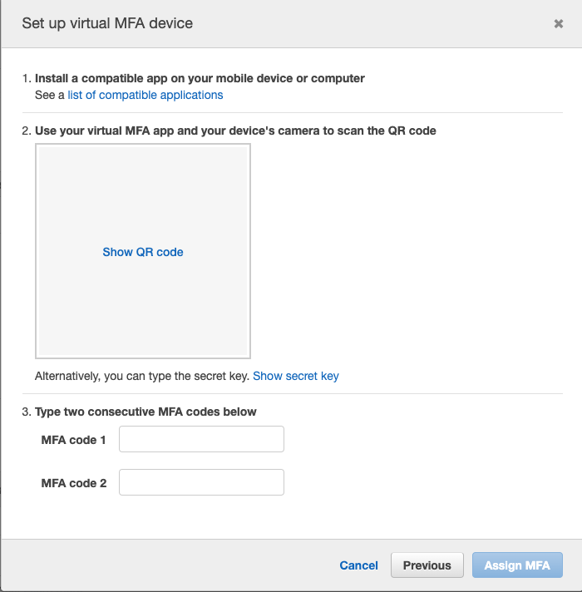
2. Click Manage next to the Assign MFA device
3. Leave the default Virtual MFA device option on and click continue
4. Click the Show QR code in the empty square

Slide 20
5. Open the Google Authenticator app on your phone and click the Scan a barcode camera icon
6. Scan the barcode
7. Type the code you see on your phone into the MFA code 1 field
8. Wait for the Google Authenticator app to generate the next code
9. Type the next consecutive code into the MFA code 2 field and click the Assign MFA button
10. Using a new incognito or private browser window to login with this user and the MFA code from your phone
If you have configured MFA correctly you should be able to log in.
If not:
Log in as the root user
Proceed to the IAM service console
Click on Users
Select the manager user
Visit the Security credentials tab
Next to Assigned MFA device, click Manage
Remove the assigned MFA device
Log out of the root user account
Log back in with the manager account
Try again to configure MFA

Slide 21
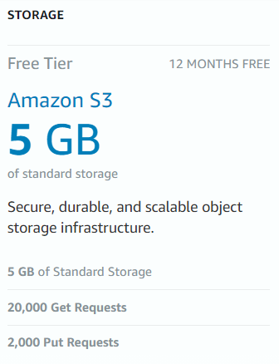
Exercise: Creating S3 Bucket And Uploading Content
Instructions
If you have not done so already, register with AWS and authenticate as the manager user
Create a bucket in the us-west-2 Oregon region
Create 2 folders in the bucket: "exercise" and "manager"
Upload content to both folders (a single file in each folder will suffice)
Note: Please do not delete the bucket until the end of this course. Deleting a bucket takes a long time. If you delete the bucket and then try to create it again later, you may run into errors.
Intro to Cloud Computing https://www.udacity.com/course/intro-to-cloud-computing--ud080

Slide 22
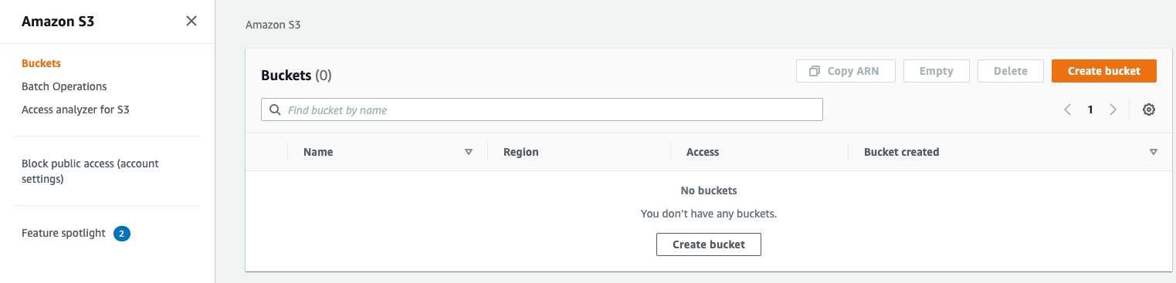
Part-1: Creating The Bucket
1. Log out of the root account user by clicking on the top right email next between the Bell icon and the Global dropdown menu
2. Log in to the console as the manager, using the information from you've got from the previous step
3. Navigate to the S3 console
4. Create a new bucket (remember that bucket names are globally unique across all AWS accounts)
Note that if a bucket name already exists you will get a warning.
Note:
Deleting a bucket takes time, so creating the same bucket name after a deletion would not allow you to create the bucket and will result in a "Bucket already exists error"

Slide 23
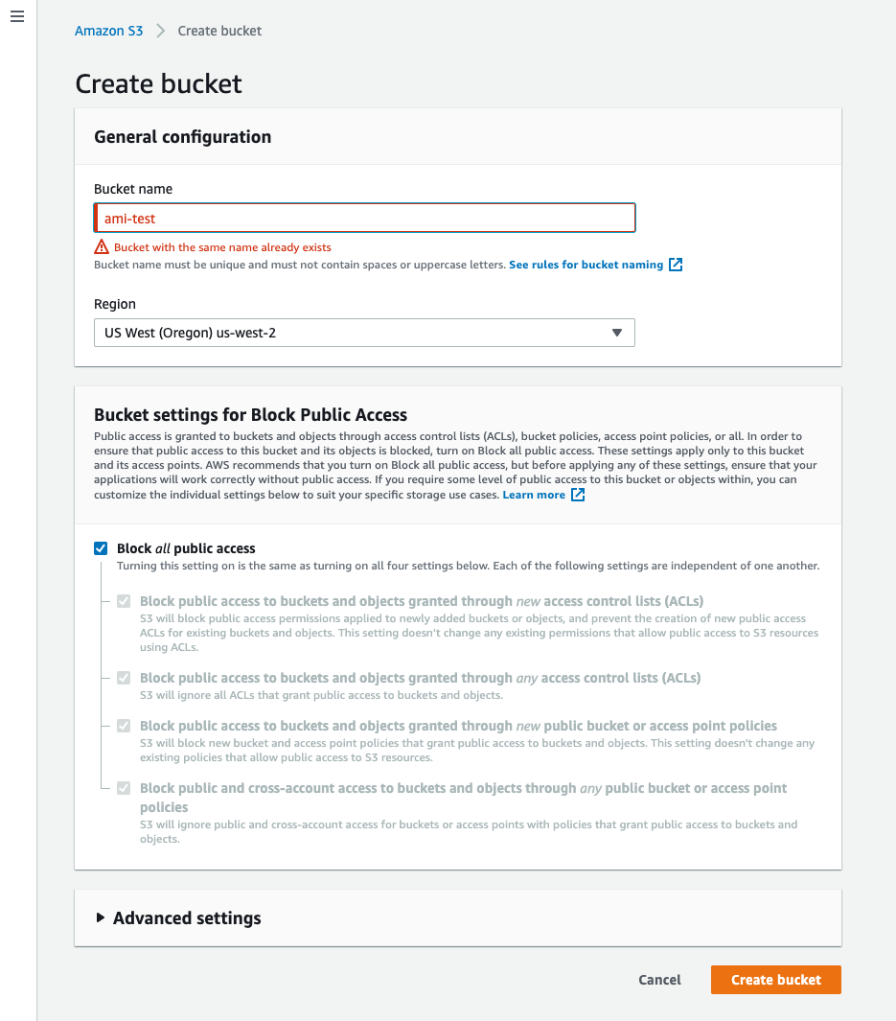

Slide 24
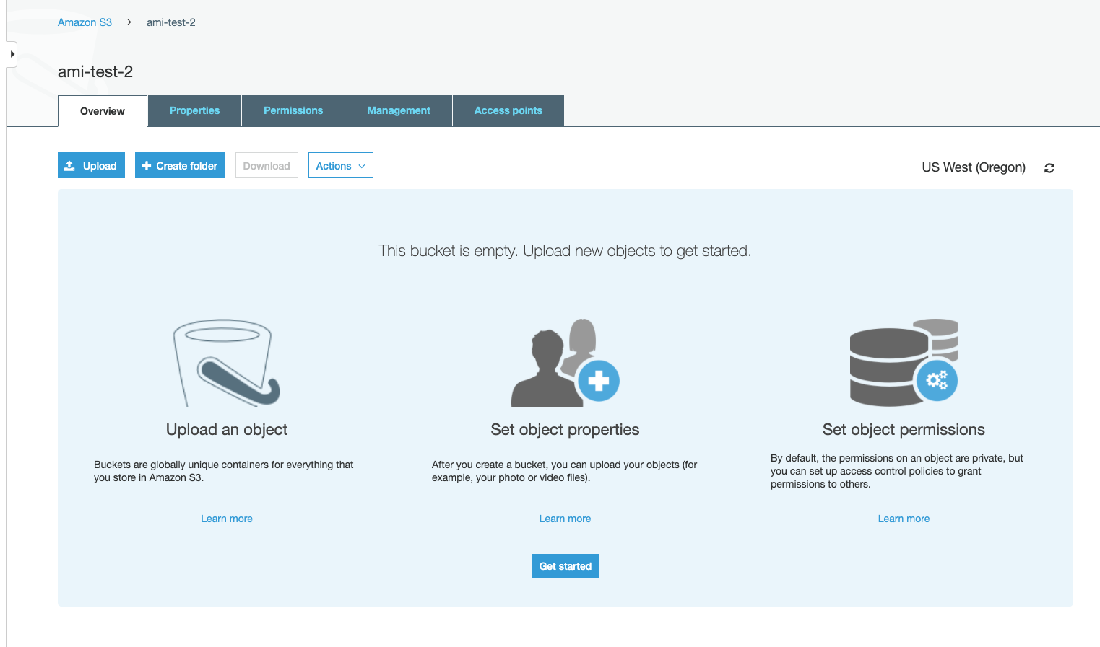
5. Once the bucket is created, click on the Create folder button to create a manager folder

Slide 25
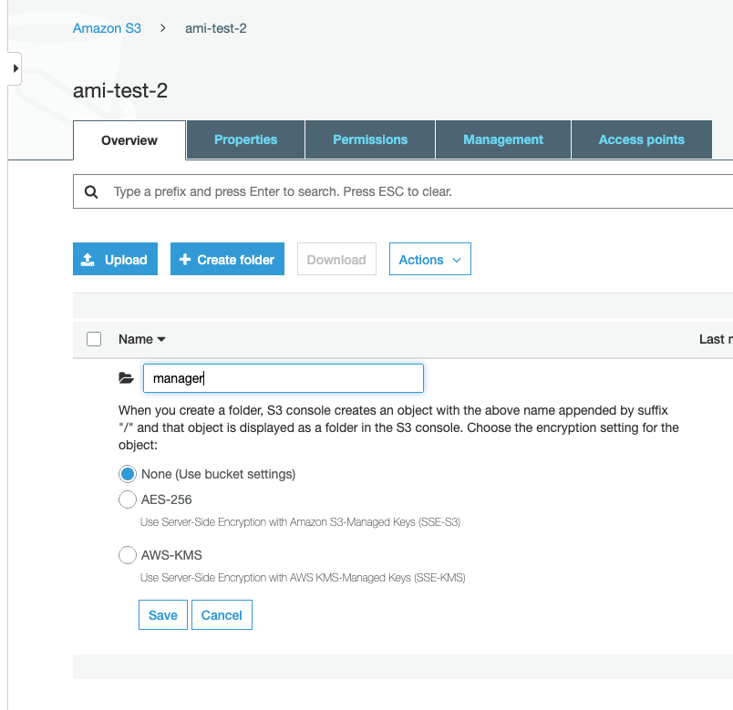

Slide 26
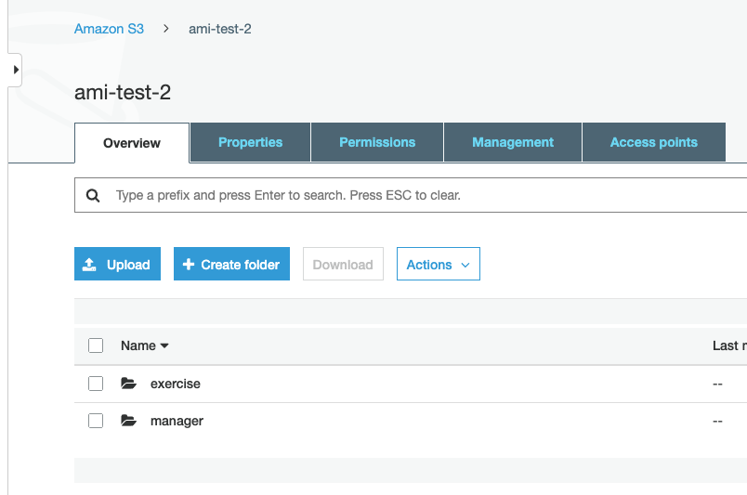
6. Create another folder called exercise

Slide 27
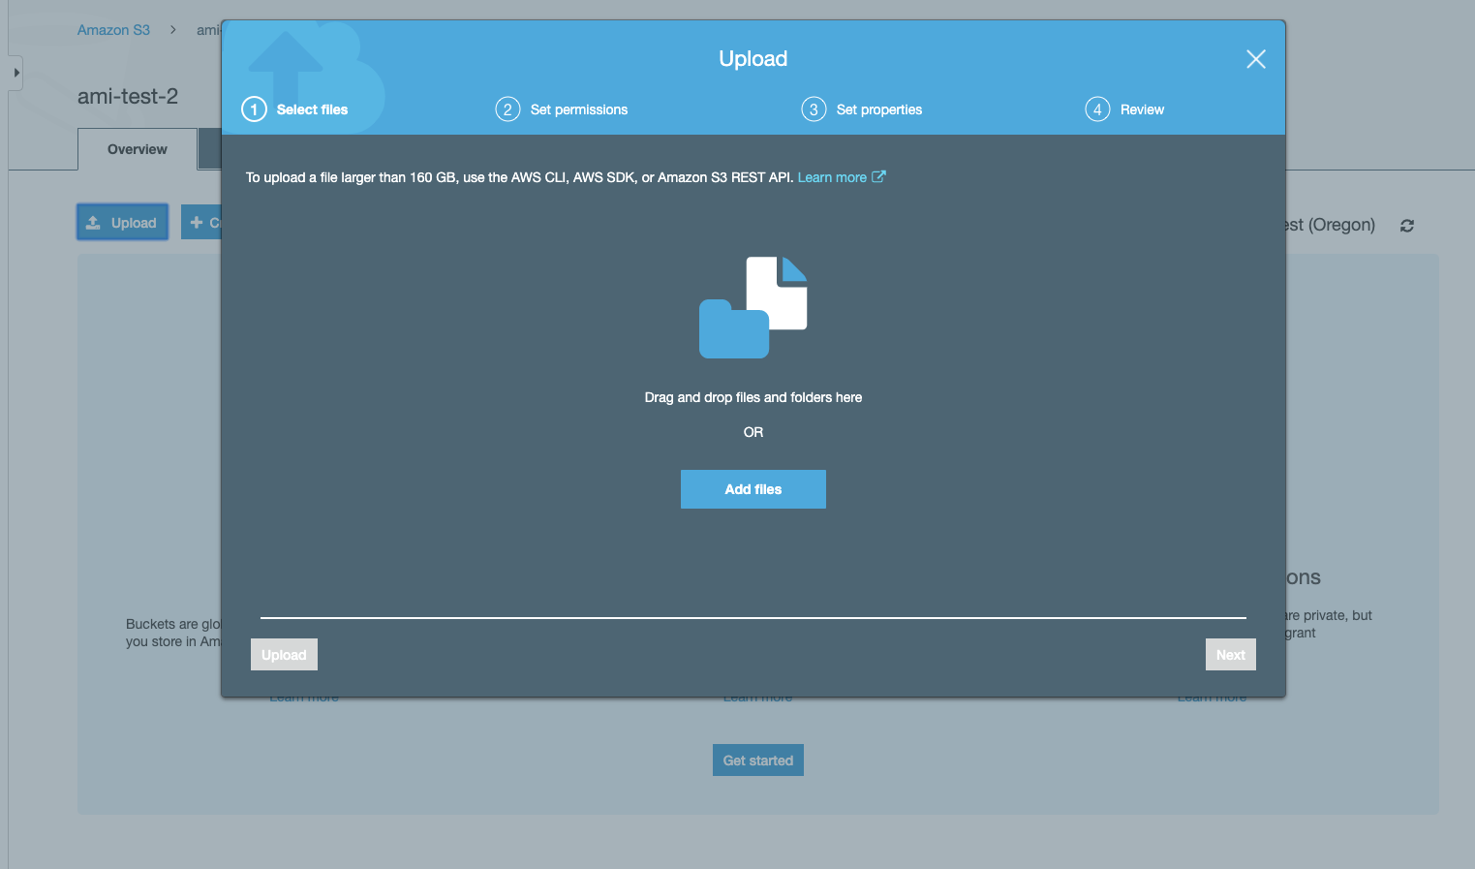
7. Click on the exercise folder to get into that folder
8. Click on the Upload button to upload a file (any file) into that folder

Slide 28
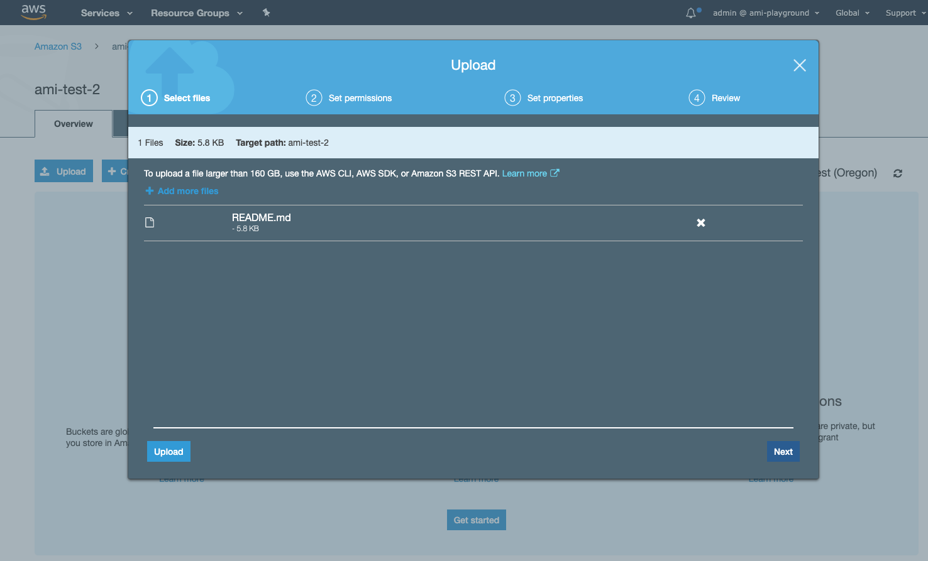
9. Either drag and drop a file onto the window or click the Add files button to start the upload process

Slide 29
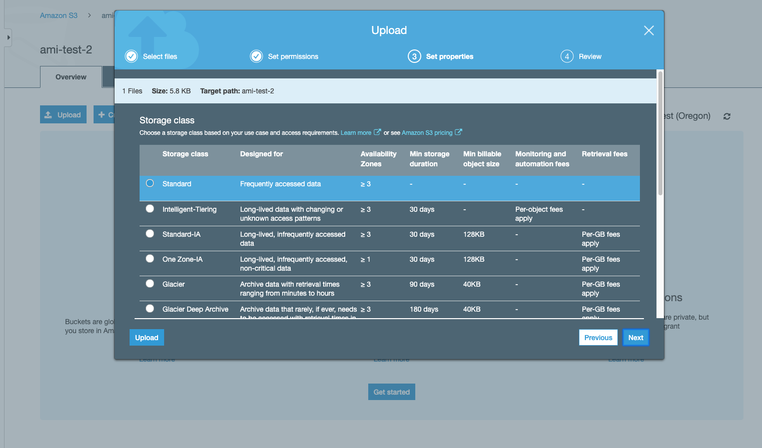
10. Click the Next button to see the list of default permissions for this file (we will use IAM permission to access it rather than resource permissions)
11. Click Next to see the S3 storage classes, and leave the default Standard class selected

Slide 30
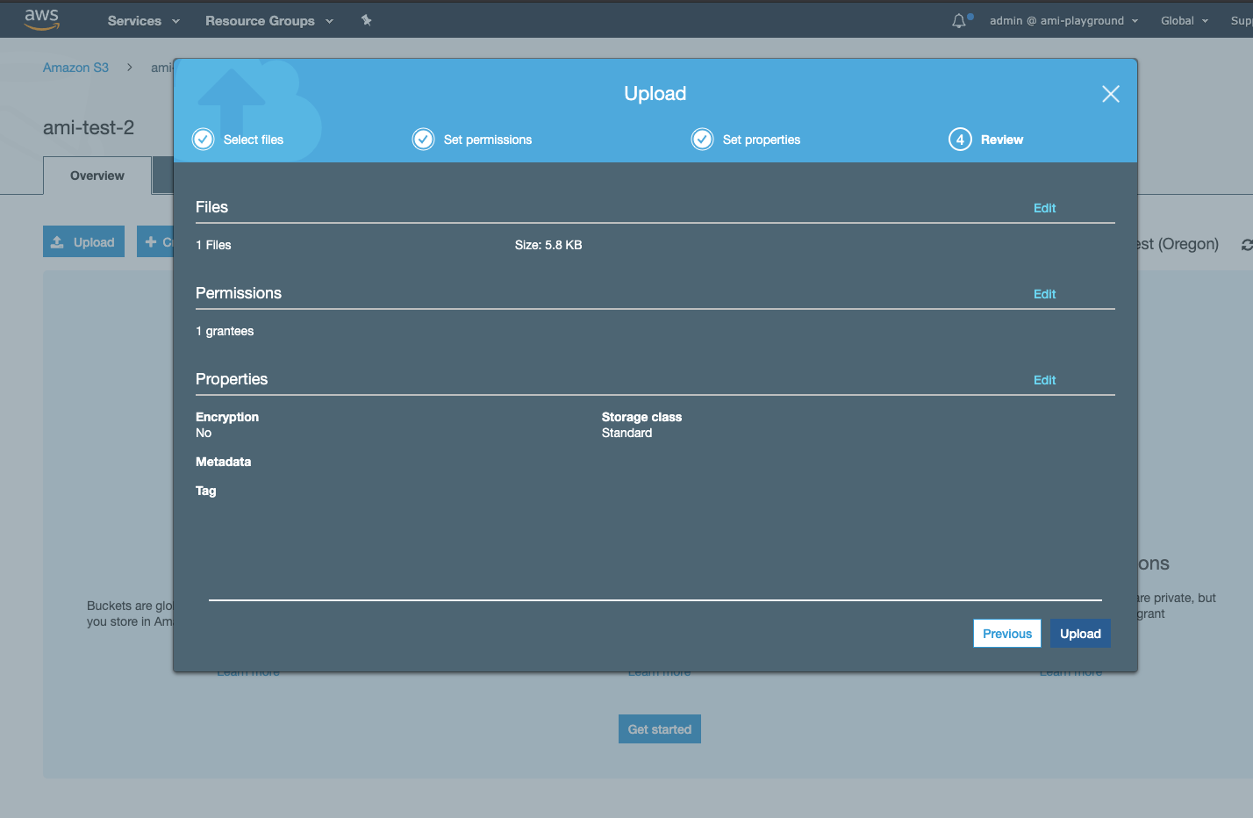
12. Click the Upload button to start the upload.

Slide 31
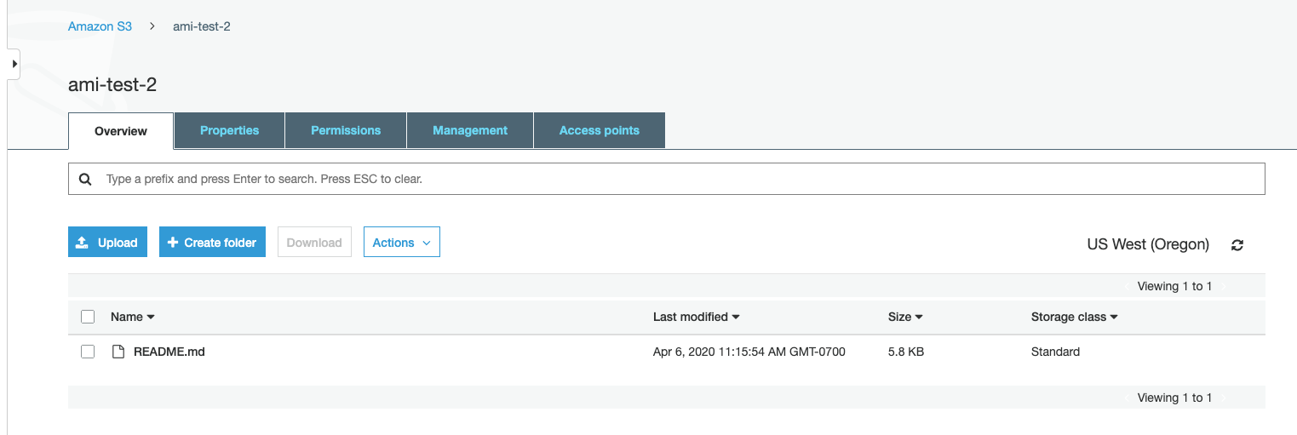

Slide 32
Monitoring your AWS costs
All AWS services are a pay-as-you-go service, so we urge our students to closely monitor their usage costs and if they have adequate credits available to complete their project/task. Follow the instructions below to do that:
Step 1. Log into your AWS account.
Step 2. Examine your costs
Go to https://console.aws.amazon.com/billing/
You should see the following billing dashboard where it will show your costs.
Intro to Cloud Computing https://www.udacity.com/course/intro-to-cloud-computing--ud080

Slide 33
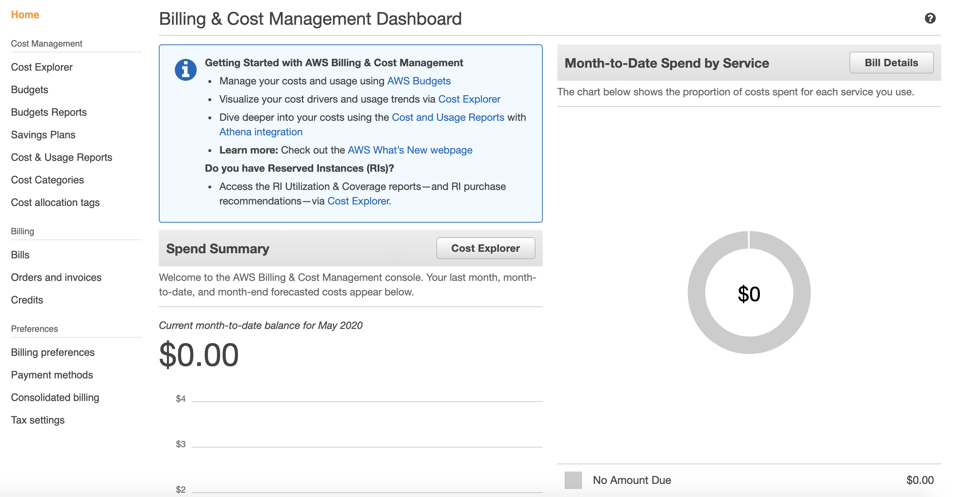
Monitoring your AWS costs
Intro to Cloud Computing https://www.udacity.com/course/intro-to-cloud-computing--ud080

Slide 34
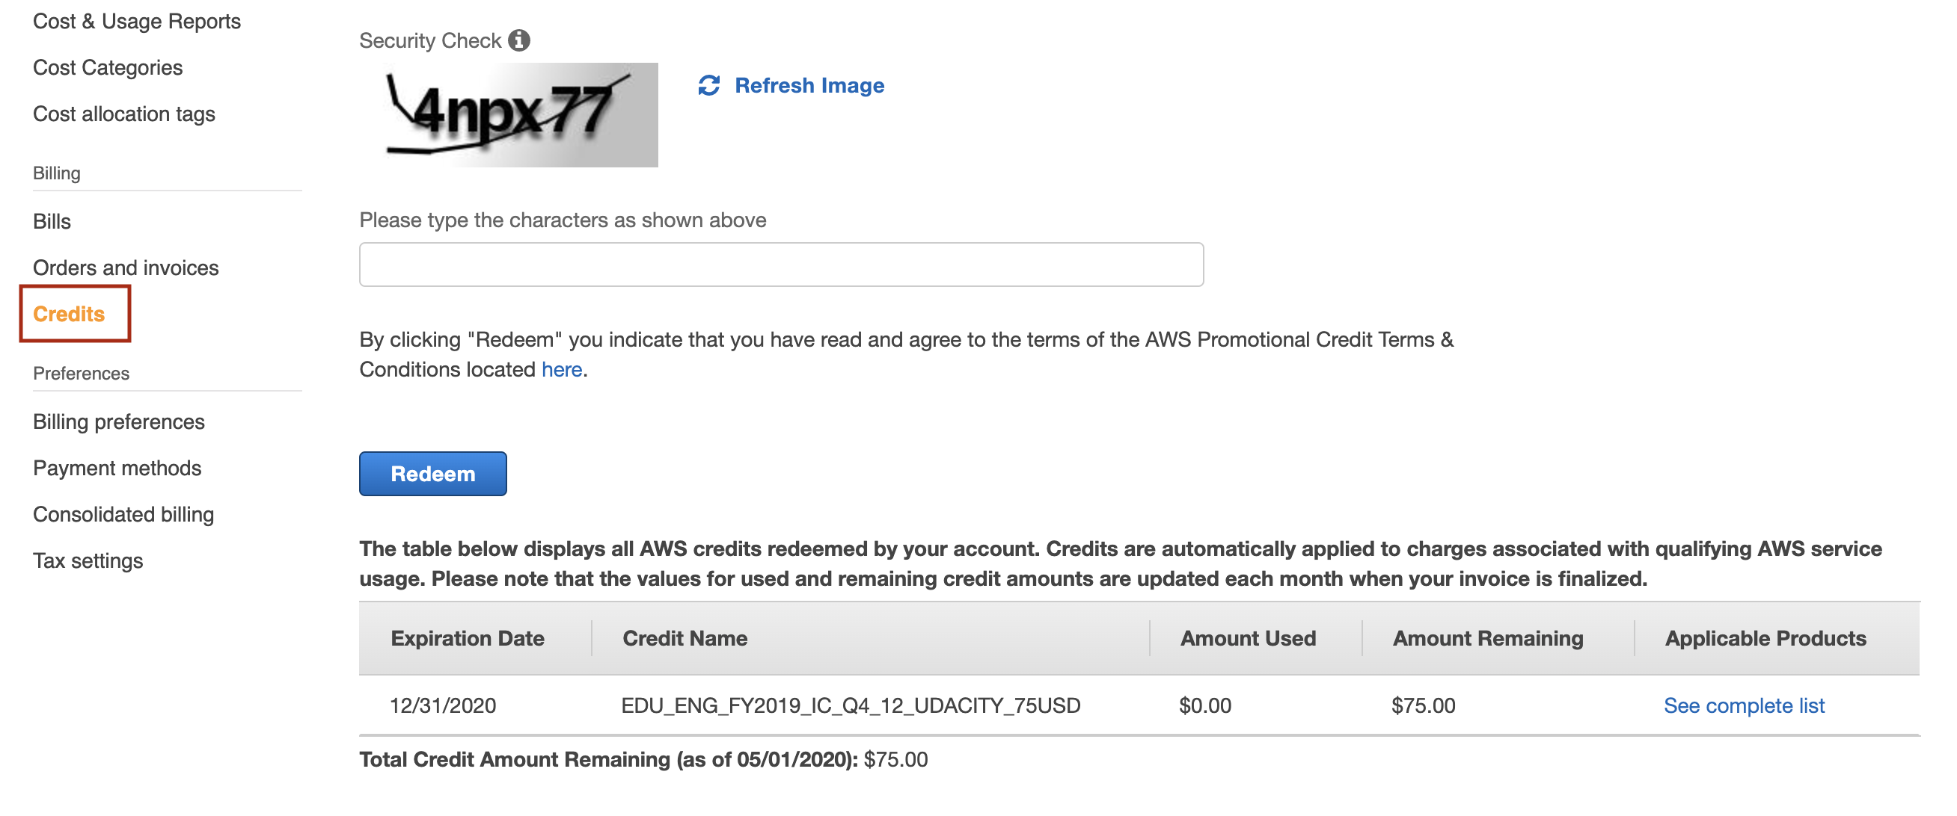
Monitoring your AWS costs
Step 3 (optional). Check the value of your credits.
Click on the "Credits" from the left side menu and the following screen will show with your available credits.
Intro to Cloud Computing https://www.udacity.com/course/intro-to-cloud-computing--ud080

Slide 35
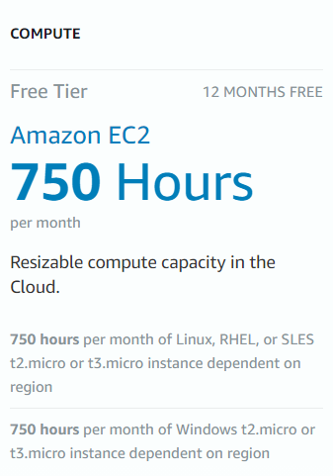
AWS Elastic Compute Cloud (EC2)
Resizeable, scalable compute capacity
Instances sizes are predefined by instance types
Configuring an instance can be done within the EC2 Launch Wizard:
  Security groups (i.e. firewall rules)
  Networking (public or private)
  Storage size and type
  Custom provisioning scripts
Intro to Cloud Computing https://www.udacity.com/course/intro-to-cloud-computing--ud080

